Slide 1
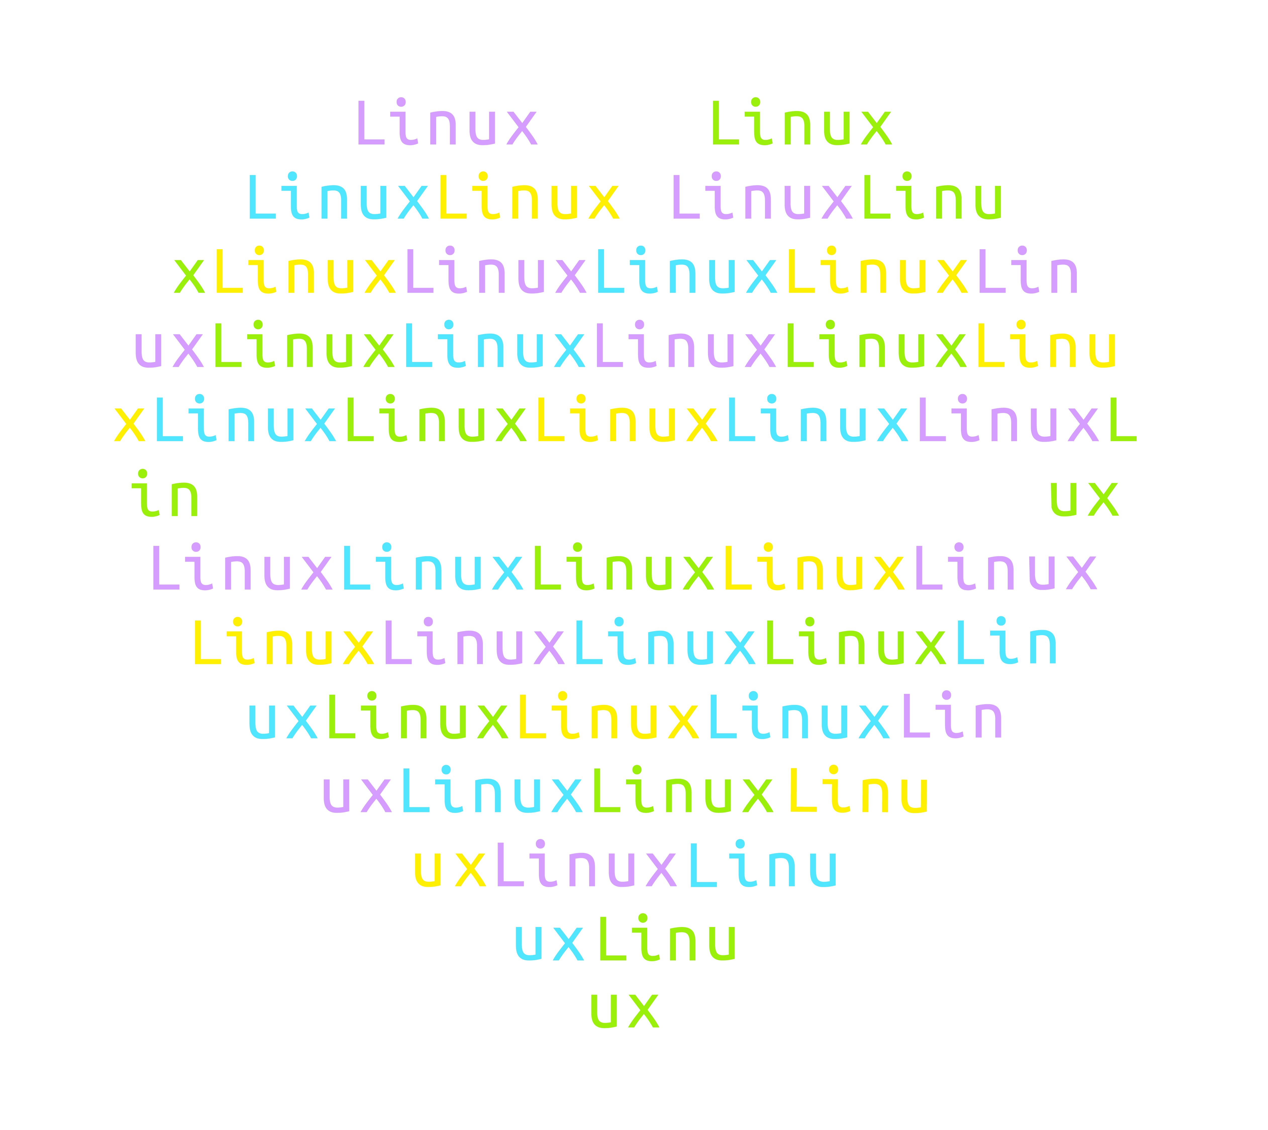

Azure
Open Source and Cloud-native Day
March 15, 2023

Slide 2

Innovation using a cloud-first approach for businesses.
Alex Aitken
AVP Engineering

Slide 3

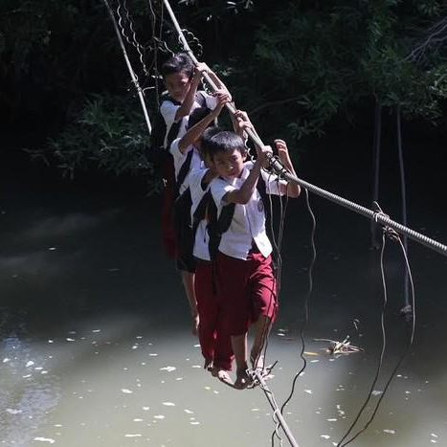
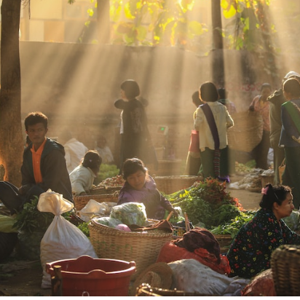
Our mission: To provide a fair economy for all
To empower offline and online MSMEs through the use of technology,
We aim to create opportunities to level the playing field for all.
We believe that we can tackle the core challenges that hinder MSMEs from growing and thereby lead to a better economy for Indonesia.
Areas we want to touch:
Financial Inclusion
Infrastructure
Technology

Slide 4
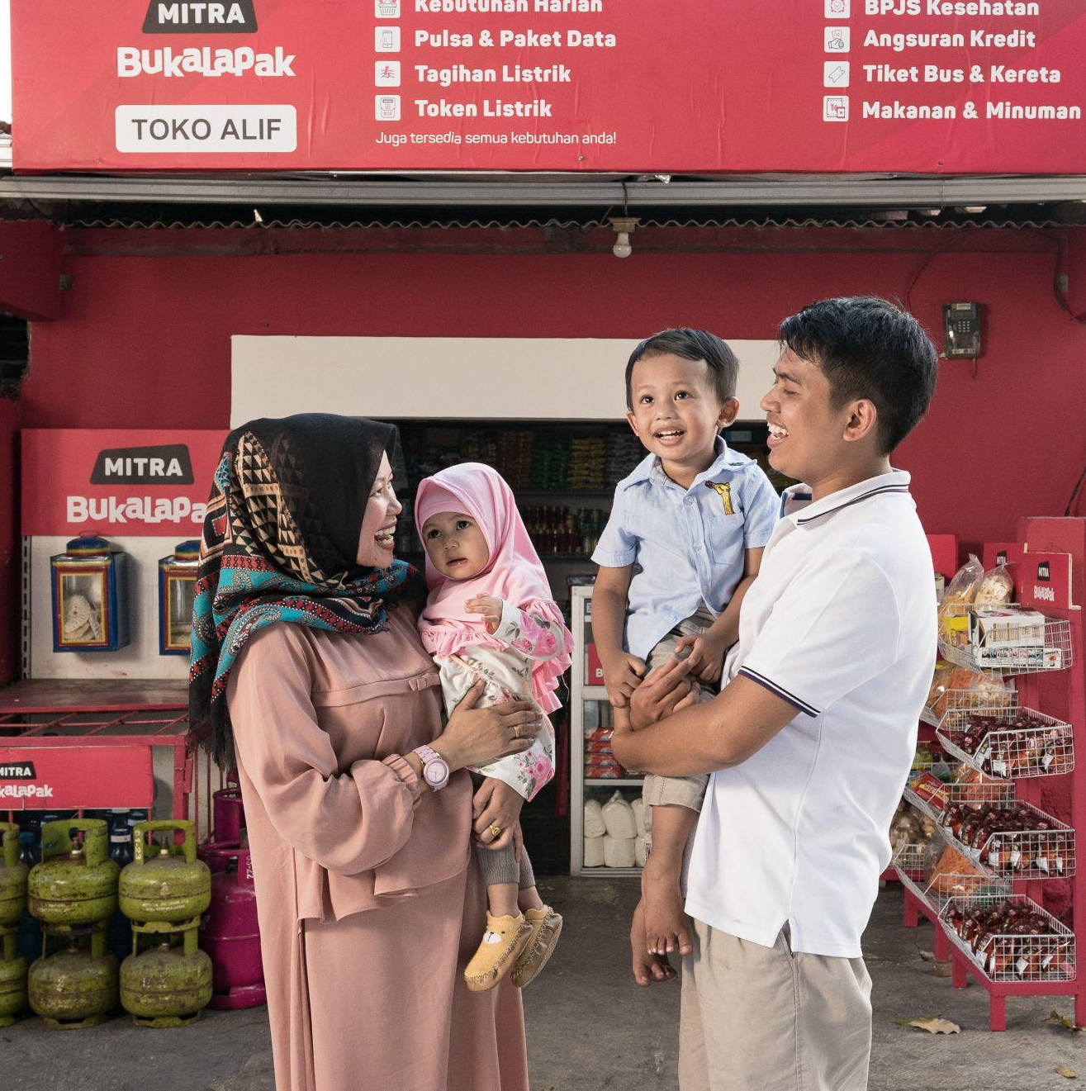

Bukalapak has a mission to empower MSMEs by optimizing their full potential and enhancing their competitiveness level
Access to credit & other financial services
More revenue streams from new product offerings
More access to new customers segments
Better business process

Slide 5

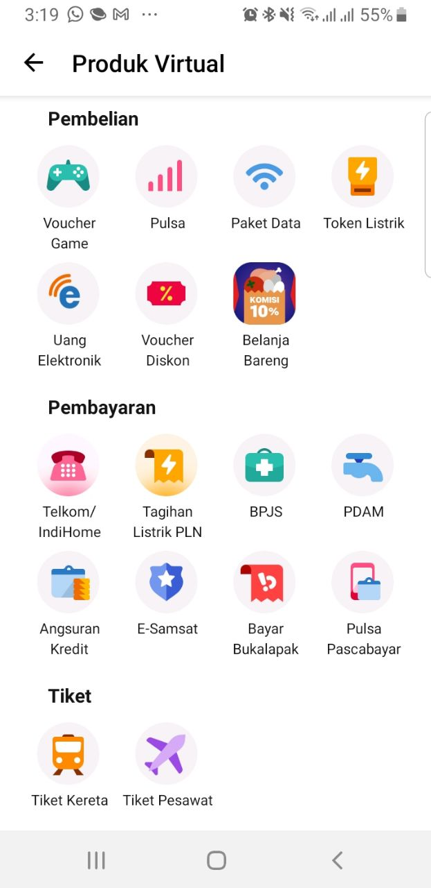
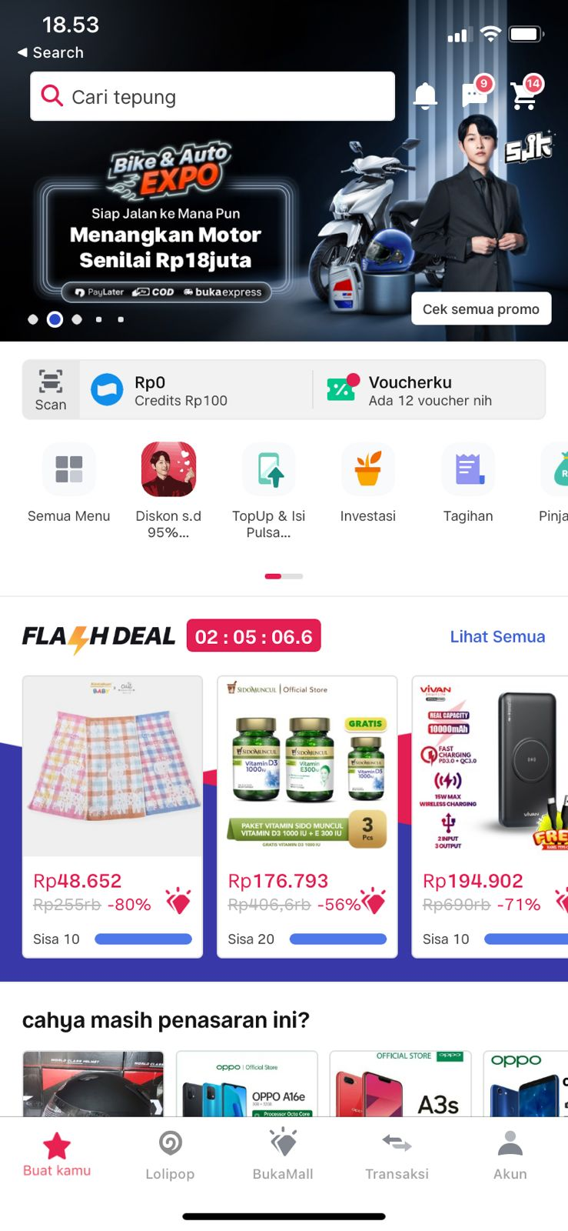
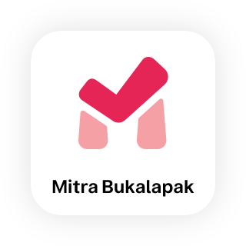

Bukalapak has >110 million user base; both online and offline
Bukalapak marketplace optimizes millions of sellers through online marketplace
Level-up warung through technology and innovation
MSMEs Merchant:
~6.9 Mn
Online Users:
> 110 Mn
Warung & Individual
~15.2 Mn

Slide 6
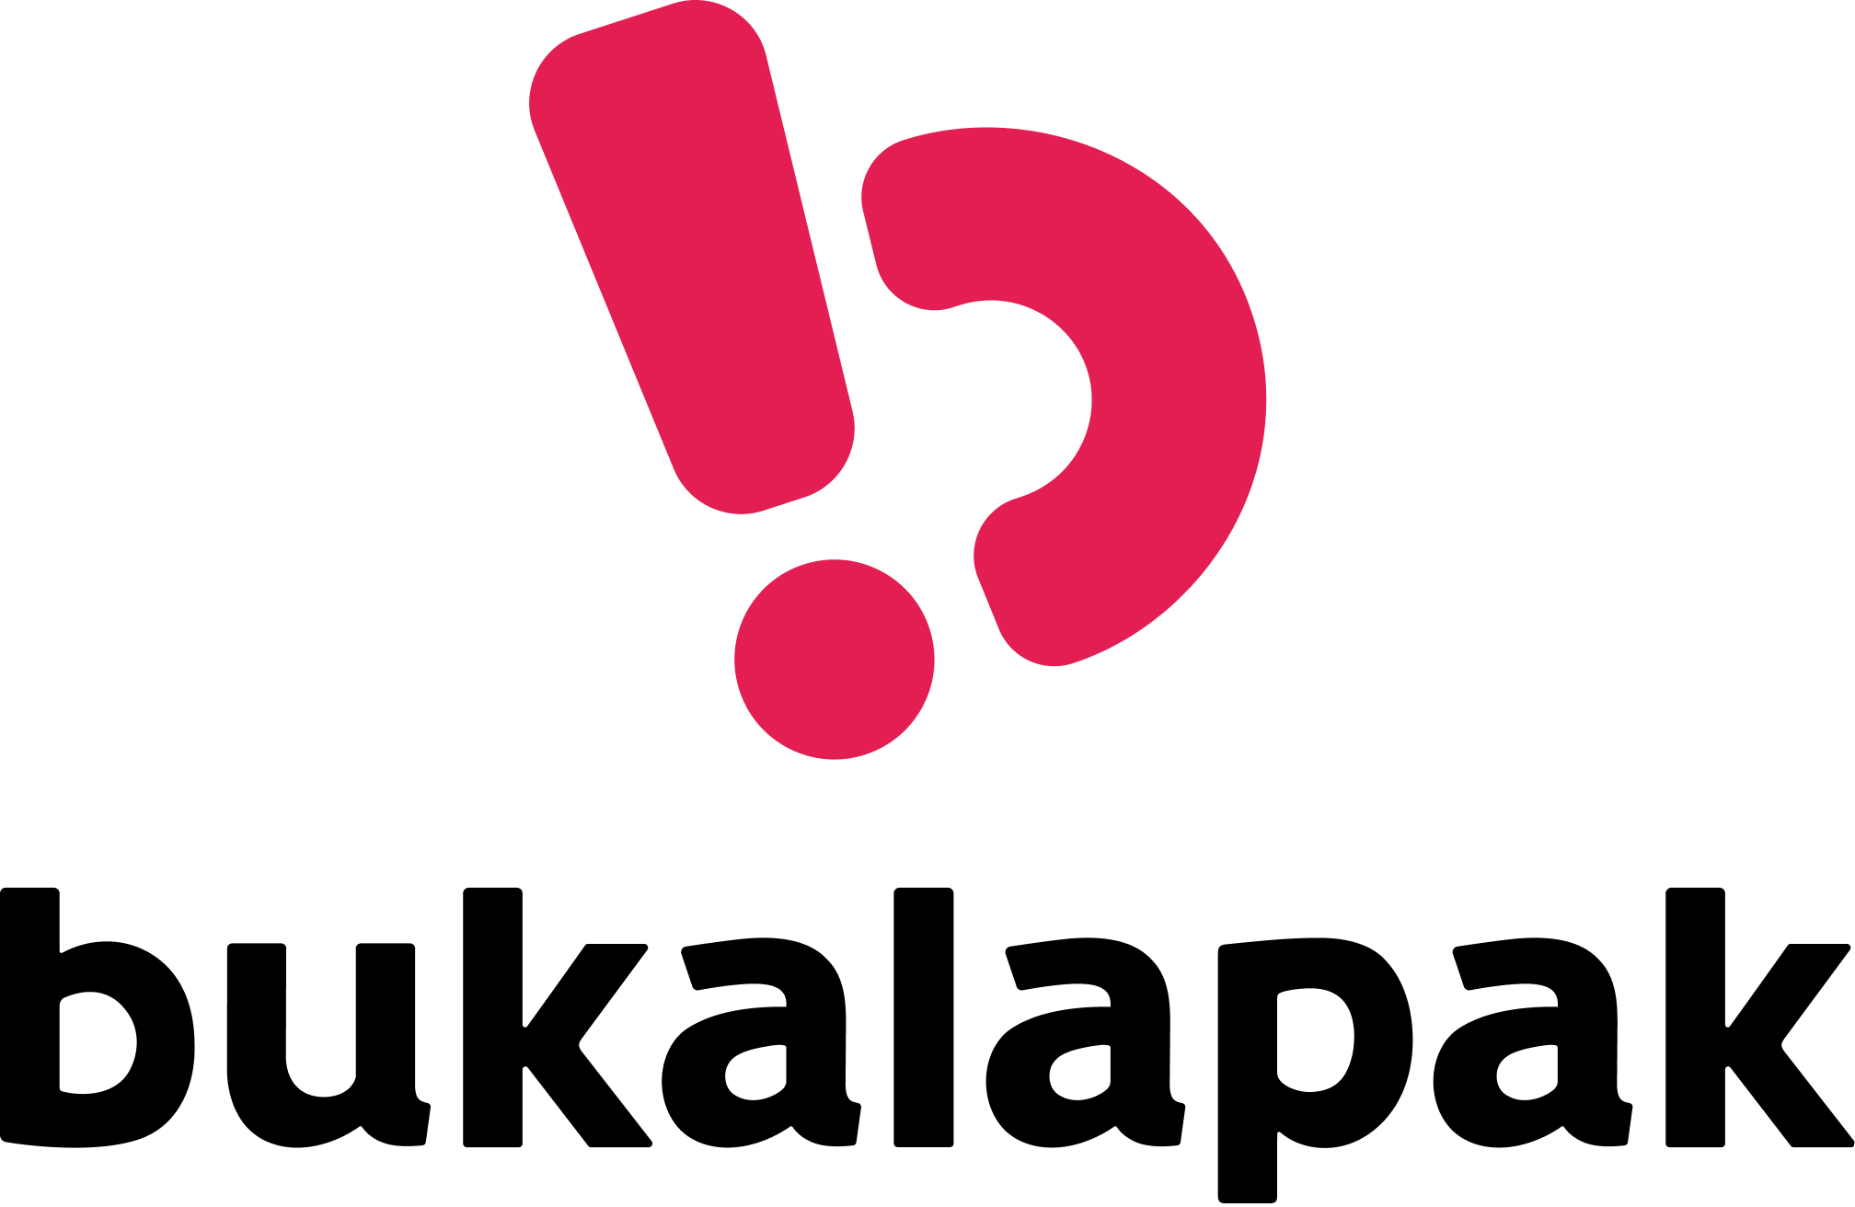
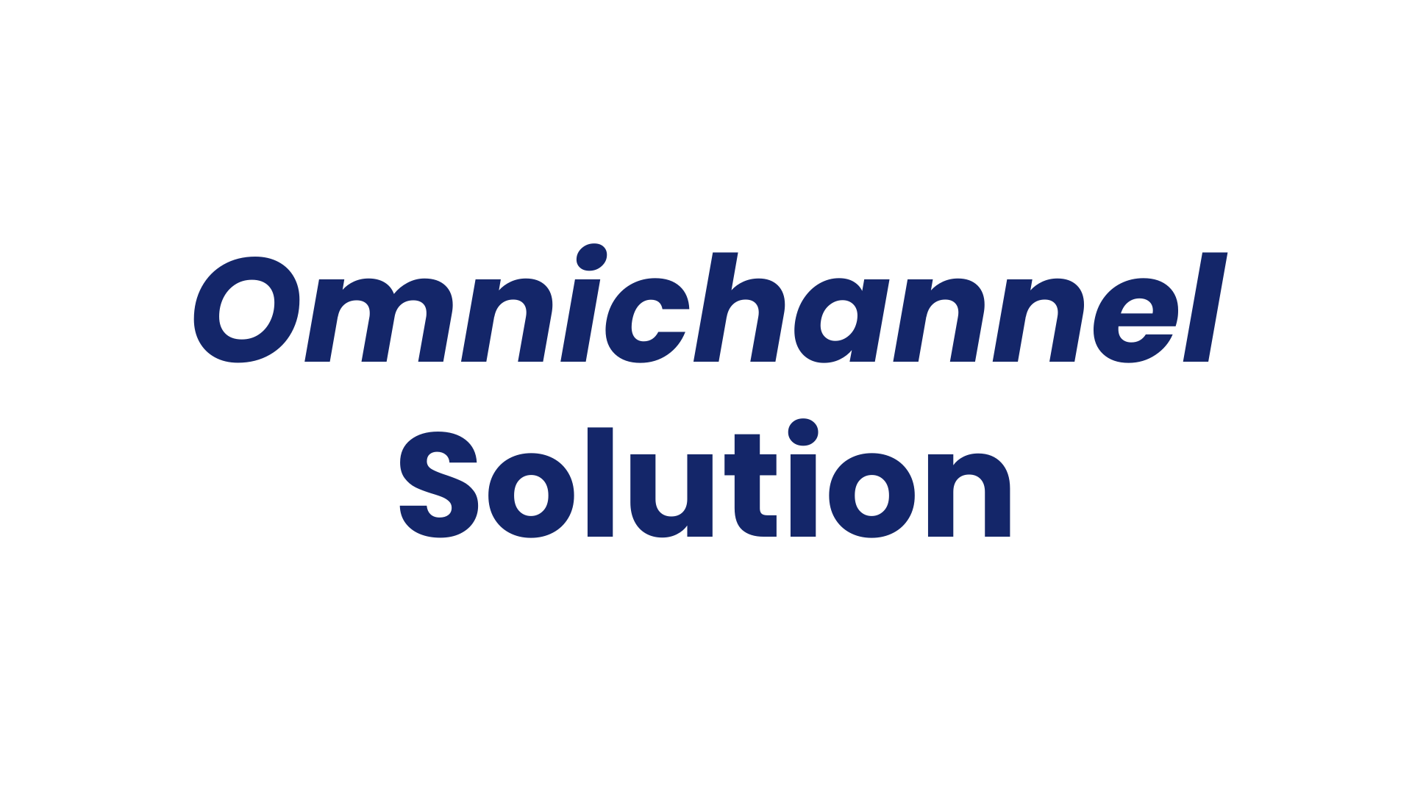


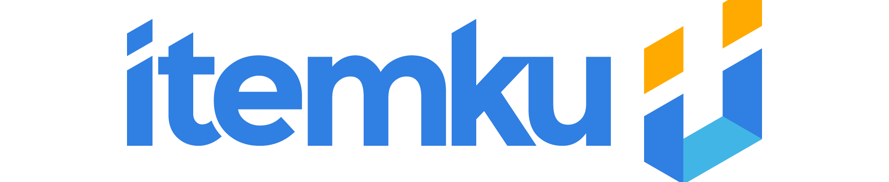

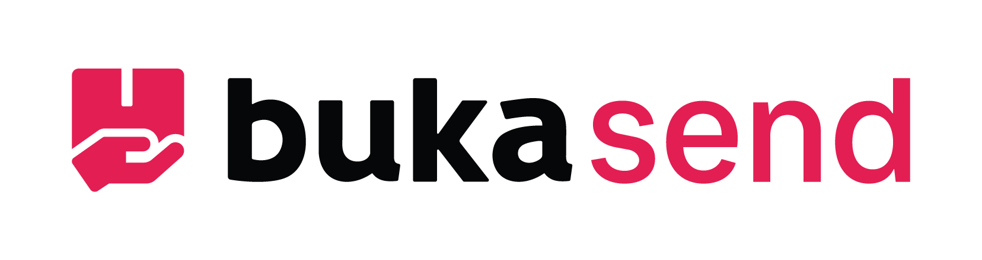


Buka is expanding its open ecosystem
Extend the reach to mitra, online merchants, and end-customers by providing the best-in-class solution
Marketplace
O2O
Merchant
Solution
Financial
Platform
General marketplace
B2B MSMEs platform
Digital Bank
Gaming item marketplace
Financial management application for MSMEs
Logistic agent
Investment platform
E-grocery with B2C, B2B, quick commerce dan Click & Go features

Slide 7
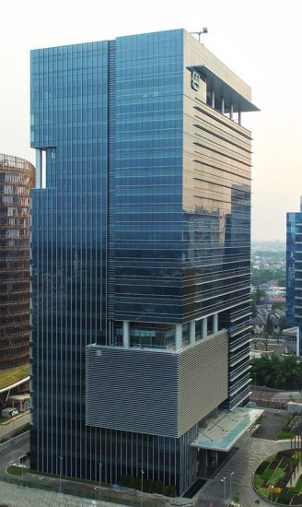



We are expanding our reach globally to serve Indonesia Market and beyond
Jakarta
Melbourne
Singapore

Slide 8
















B2B
B2C
C2C
Products
Business
Shared domain
Reusable domain
App + web
Infra
Data + AI
Cloud infra
Logs + monitoring
Design Patterns
Storage + Cache
Quality + Testing
Security + Compliance
Networking
HA + DR + BCP
I18N + Localization
Tooling + Pipelines
Support
Tech Blueprints
Standards and Guidelines
Org Structure
Team and Culture

Slide 9

IaC means infrastructure as code.
Bukalapak uses terraform, ansible and helm charts to manage almost everything in cloud.
Benefits
Native change control process (code review)
Native change history (git log)
Easy to replicate or recover
IaC for everything in cloud

Slide 10
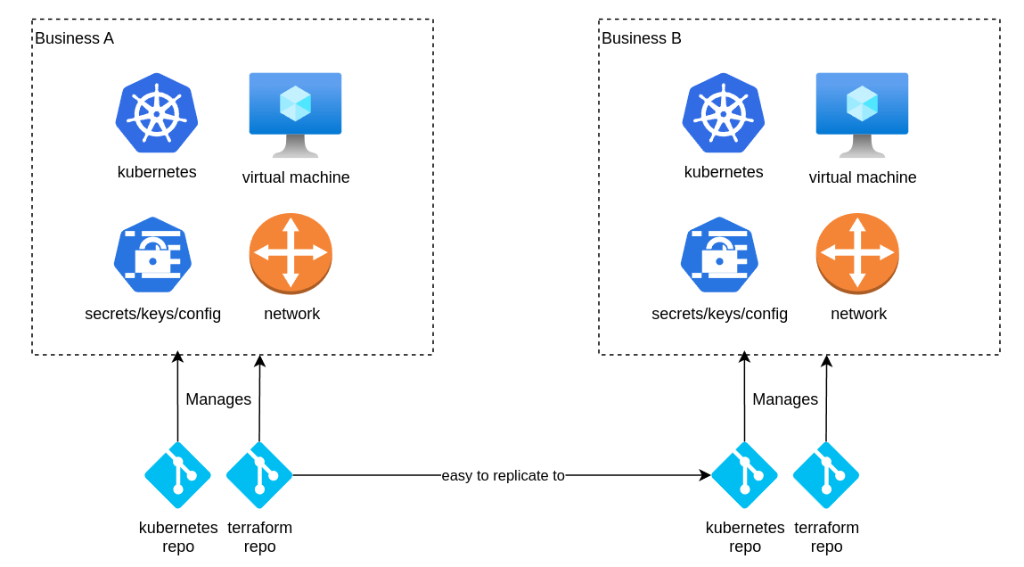
Easy to replicate
IaC for everything in cloud

Slide 11
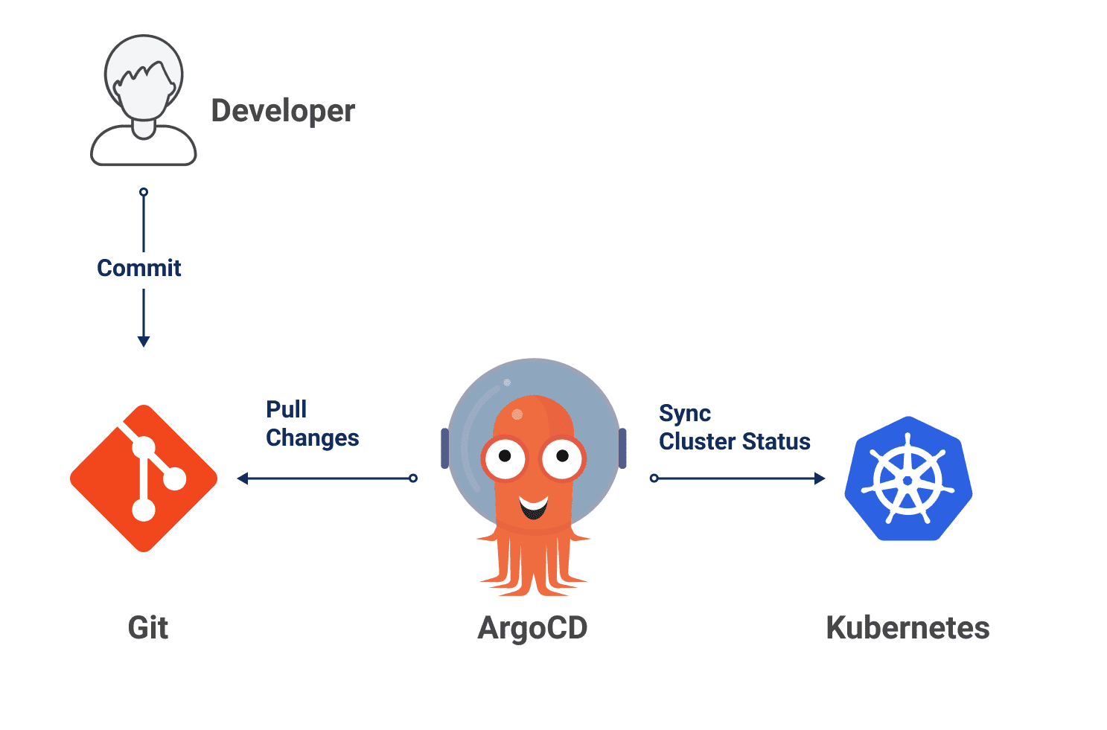
Declarative Kubernetes CD via ArgoCD
IaC for everything in cloud
All kubernetes manifest managed in 1 repository for 1 business
Helm chart dependencies and version
Values for different environments
Image versions
Network policies
Etc.
ArgoCD continues syncing all the manifests to the kubernetes cluster.

Slide 12
Automate the ops
Notes:
The engineers working on software infrastructure are known as devops engineers because there are a lot operations for software infrastructure.
The operations is a limit for the number of infrastructure environments we can manage at the same time, so also limiting the number of businesses we can have at the same time.
We will talk about one example of how bukalapak automate the operations.

Slide 13
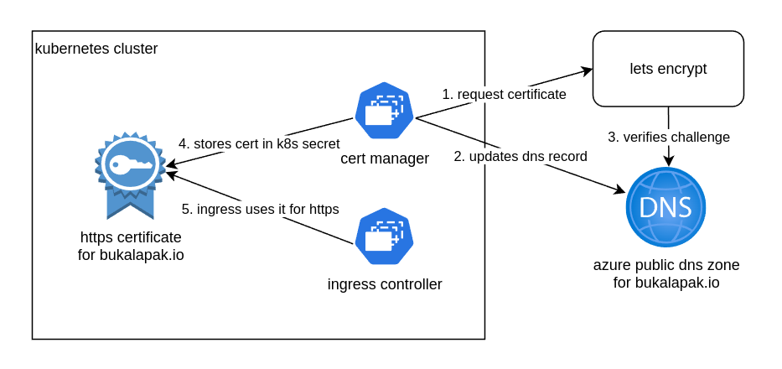
Automate HTTPS certificate using cert manager
Automate the ops
Notes:
The engineers working on software infrastructure are known as devops engineers because there are a lot operations for software infrastructure.
The operations is a limit for the number of infrastructure environments we can manage at the same time, so also limiting the number of businesses we can have at the same time.
We will talk about one example of how bukalapak automate the operations.

Slide 14
HTTPS Certificate
The Overhead
ACME Certificate
The traditional way to provision it is to buy 1 from commercial provider then uploads to the load balancer.
Needs to renew/upload for each certificate every 1-2 years.
More and more purchasing and renewal ops from more businesses.
Outage if the team forgets to renew.
Free.
Automated provisioning and renewal.
Sustainable for the increasing number of businesses.
Notes:
The engineers working on software infrastructure are known as devops engineers because there are a lot operations for software infrastructure.
The operations is a limit for the number of infrastructure environments we can manage at the same time, so also limiting the number of businesses we can have at the same time.
We will talk about one example of how bukalapak automate the operations.

Slide 15
Automate HTTPS certificate using cert manager
Automate the ops
Notes:
The engineers working on software infrastructure are known as devops engineers because there are a lot operations for software infrastructure.
The operations is a limit for the number of infrastructure environments we can manage at the same time, so also limiting the number of businesses we can have at the same time.
We will talk about one example of how bukalapak automate the operations.

Slide 16
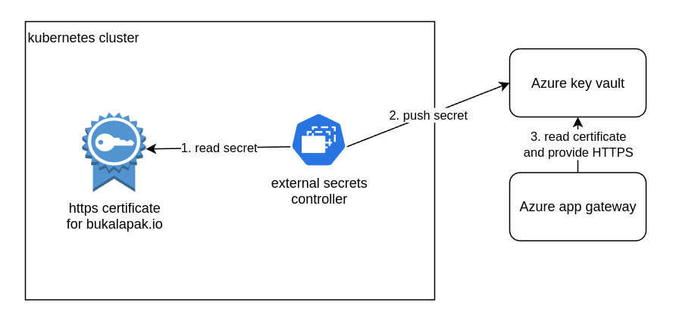
Use the certificate outside Kubernetes
Automate the ops
Notes:
The engineers working on software infrastructure are known as devops engineers because there are a lot operations for software infrastructure.
The operations is a limit for the number of infrastructure environments we can manage at the same time, so also limiting the number of businesses we can have at the same time.
We will talk about one example of how bukalapak automate the operations.

Slide 17
Bukalapak not only uses Azure, but other cloud provider as well.
The complexity of managing multi cloud is higher, but can be eased by cloud neutral technologies.
Multi Cloud

Slide 18

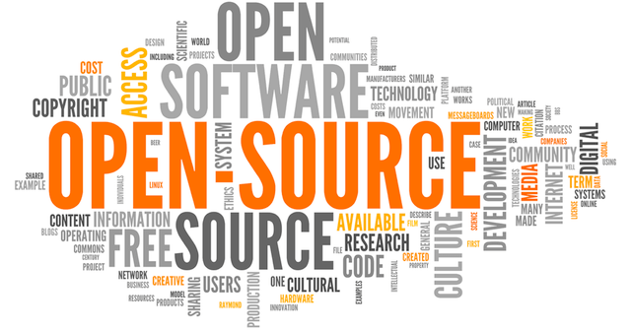
Cloud Neutral Technologies
Multi Cloud
Cloud neutral
Running kafka in virtual machines
Cloud managed Kubernetes
Cloud managed MySQL/Postgresql
Cloud managed redis
Great cloud services but cloud specific
Pub Sub
Any object storage

Slide 19
Object storage migration from other cloud to Azure
Multi Cloud
Strategy
Created a service for consuming new object event and creating the same objects in azure storage
One off sync for the old objects
One off update to the asset urls in the database
Implemented azure blob storage in the application side
Highlights
We ran the one-off sync a couple more times since we found discrepancies between how different storage handles special characters in the file name differently
Additional logic and implementation needs to be added to the application side to accommodate the migration

Slide 20

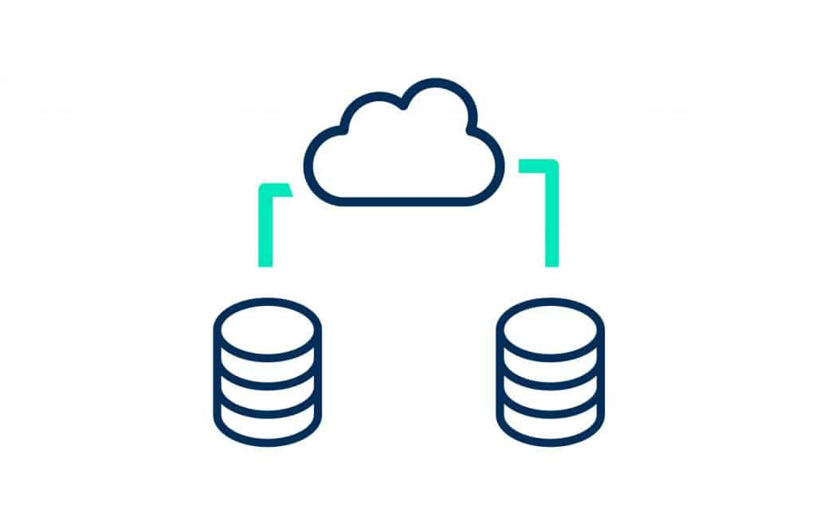
MySQL migration from other cloud to Azure
Multi Cloud
Strategy
Provision Azure MySQL
Ensure connection between Azure MySQL and the MySQL in the other cloud
Setup Azure MySQL as the replica of the MySQL in the other cloud
Fail master over to Azure MySQL
Highlights
We have done the replication and failover using MySQL protocol and commands
Nothing need to be changed in the application side

Slide 21
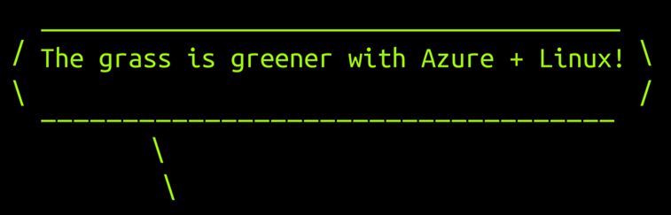
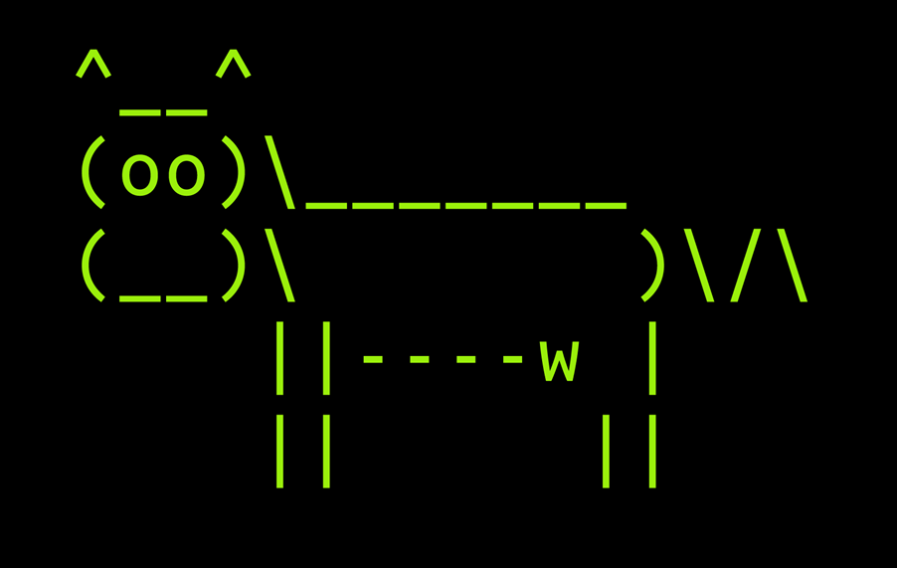
Thank you
Alex Aitken
AVP Engineering
https://www.linkedin.com/in/alexanderaitken/

